Slide 1
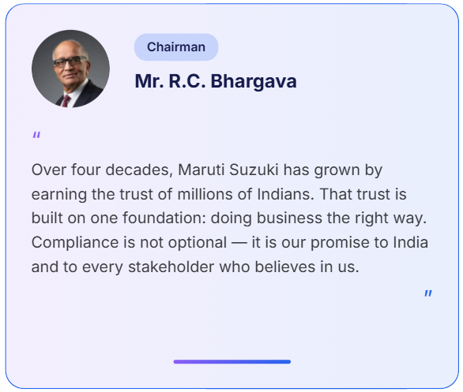
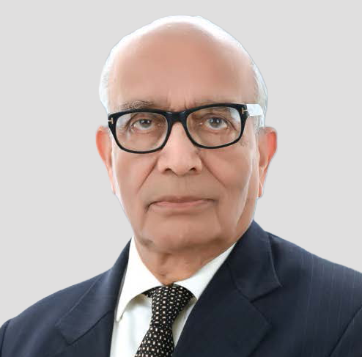

Tone at the Top
Compliance begins with conviction at the highest level
Text Length
Original: 257
Revised: 320
Update Photo and Photo size
Make designation pill colour same as MD san’s
Chairman
Update Name
Mr. R C Bhargava
Update Message
A company cannot build a sustainable and profitable business by being non-compliant or unethical in its ways of working.
Business competitiveness and profitability requires a strong element of trust in all aspects of operations. Compliance with what is ‘right’ and ‘fair’ is a fundamental requirement of building trust.
Use ‘Justify’ text alignment

Slide 2
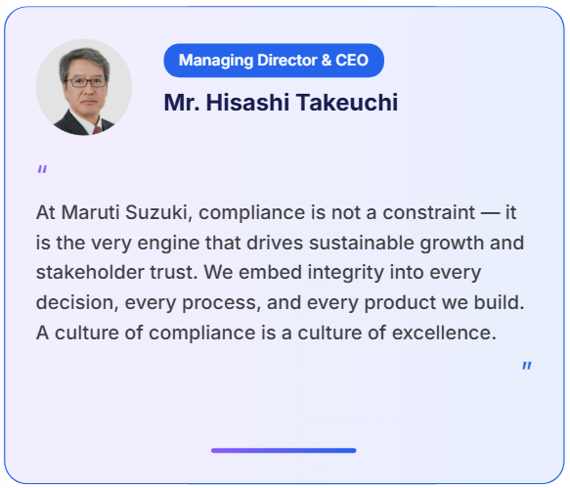
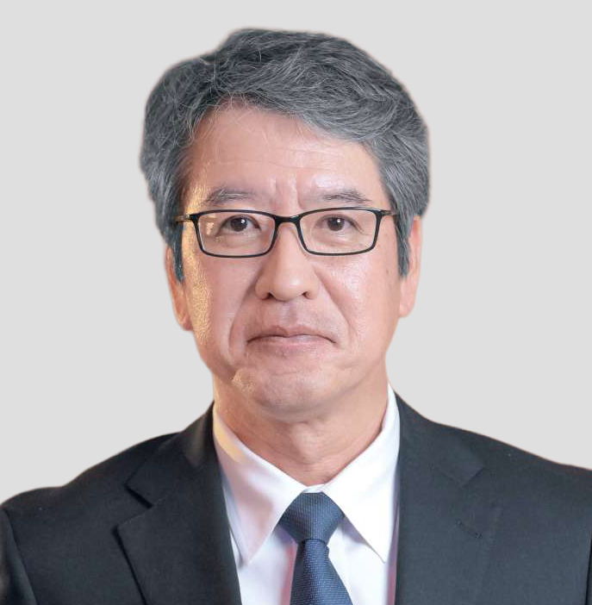
Text Length
Original: 261
Revised: 310
Update Photo and Photo size
Update designation
Managing Director and CEO
Update Message
Compliance is the bedrock on which we build credibility, and credibility is what allows growth to be both strong and sustainable.
The cost of non-compliance is enormous. It can damage our financial health, erode our hard-earned reputation, demoralize our workforce, and even compromise our license to operate.
Use ‘Justify’ text alignment

Slide 3
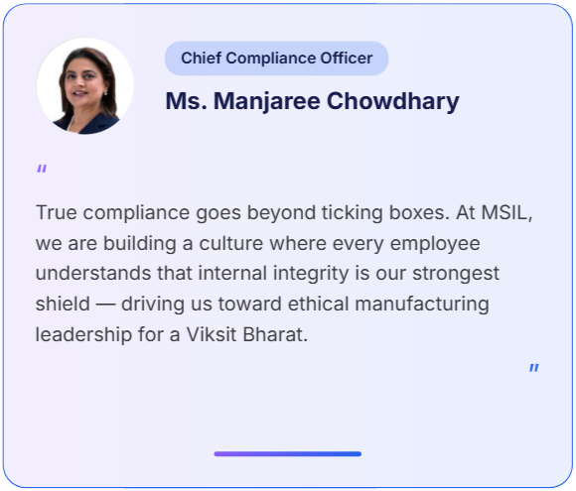
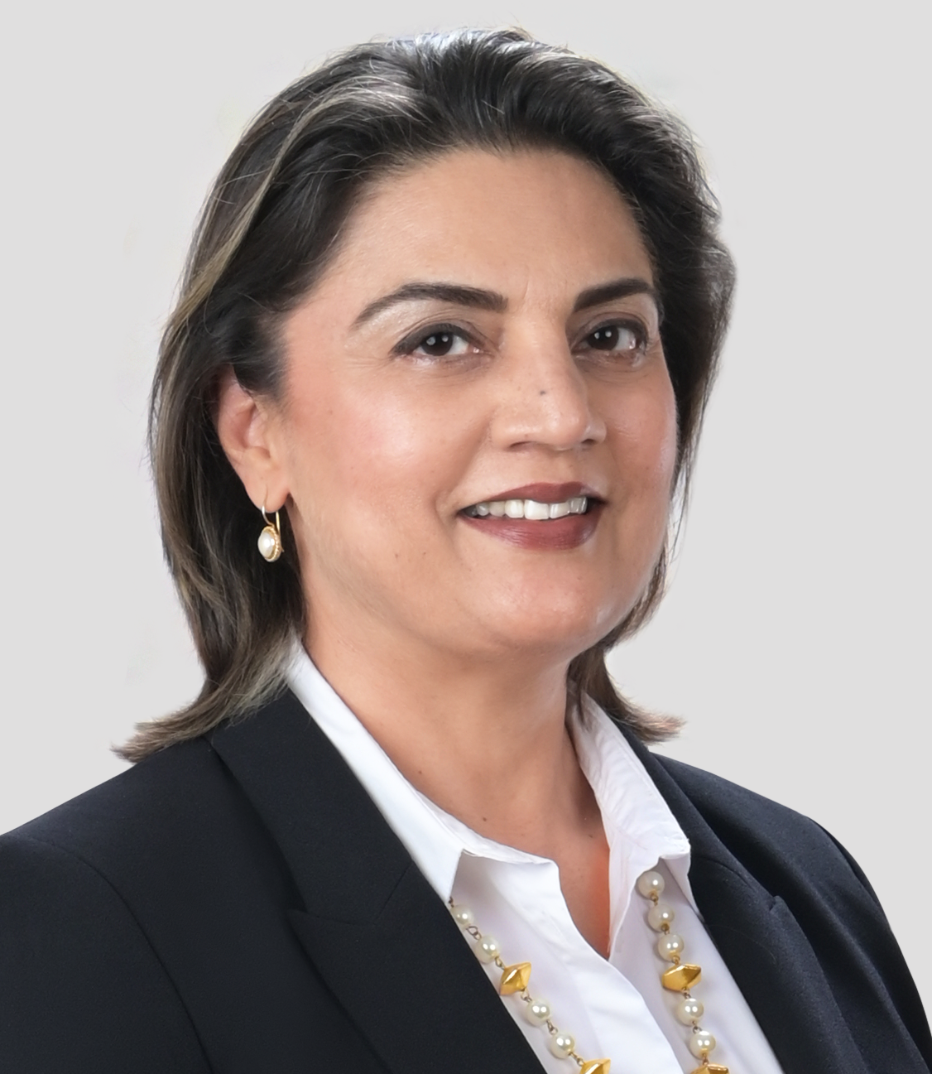
Text Length
Original: 232
Revised: 319
Update Photo and Photo size
Update designation and make colour same as MD san’s
Sr. EO and General Counsel
Update Message
New business risks and regulatory demands driven by need for sustainable future are placing increased responsibility and accountability on companies.
To successfully meet such evolving requirements, employees need to be constantly vigilant, be highly accountable and demonstrate individual ownership of Compliance.
Use ‘Justify’ text alignment

